Slide 1

BU Spark! BU Athletics
Yuchen Li
Shiyi Chen
Gukai Chen

Slide 2



Team Breakdown
Yuchen Li
MSDS
1st Year Graduate
Shiyi Chen
MSDS
1st Year
Graduate
Steven Chen
MSDS
1st Year
Graduate

Slide 3
Project overview
Client
Kate Bergstorm, the executive associate commissioner for the America East Conference, a senior associate director of athletics
Project Description & Context
BU Athletics is interested in understanding how well a student will perform academically during their time at Boston University based on the student’s high school GPA, geography, demographics, language proficiency for international students, etc. The goal is to help BU Athletics understand:
How they can better support future student athletes
Assist coaches in the recruiting process to understand if/where a student may struggle or thrive

Slide 4
Data Overview
Raw Data: Past BU athletes information (2020-2023) provided by the client
44 columns, 624 rows
Sports team, Demographic, Gender, Race/Ethnicity, Enrollment College/Major, School Year, High School GPA, Standardized Test Score, Semester-based College GPA
Data Cleaning
Drop all unrelated, empty columns
Check for null entries
Check for data types (ensure certain columns are in numerical form)

Slide 5
Base Analysis
Does English being the primary language of the country impact the students’ performance?
Does the average student athlete improve their GPA throughout their college year?
How do these students with high SAT/ACT scores or high GPA perform academically at BU compared to student athletes with low SAT/ACT scores or low GPA?
Do students from certain geographic areas perform better academically than another geographic area?
Are there any significant differences in the academic performance of student athletes based on their sport?
Notes:
language proficiency, standardized test score, geographic, sports team, overall college GPA trend

Slide 6
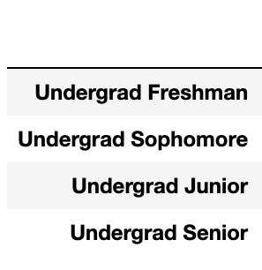
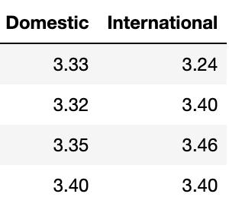
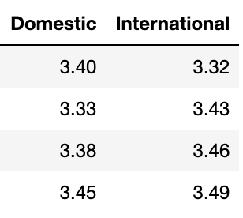
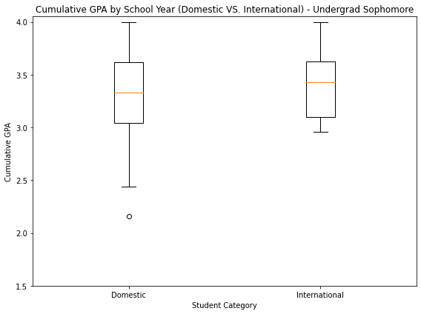
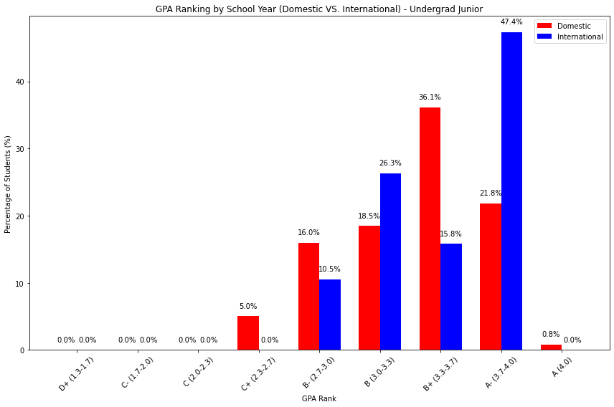
Does English being the primary language of the country impact the students’ performance?
Mean
Median
Key Insight:
English being the primary language MAY NOT significantly impact the long-term academic performance. From short-term aspect, international students might need a longer period of adjustment to new educational system (college).
Junior
Sophomore
Notes:
Approach:
Separate data into domestic and international students. (Domestic: 526 (84.4%), International: 97 (15.6%))
Compare the range, mean, median of BU GPA for each school year.
Overall, except for freshman year, international students generally perform better
For domestic students: generally wider GPA range with the presence of lower outliers (see the box plot) and larger interquartile range, indicate higher variability.
However, the variability tends to decrease with advancing class year for both groups.
Prove that both groups need a period of adjustment
Compare the percentage of each GPA rank between domestic and international students.
GPA rank: C+ (2.3-2.7), B- (2.7-3.0), B (3.0-3.3), B+ (3.3-3.7), A- (3.7-4.0), A(4.0), A+ (4.0+).
Generally similar in distribution, sometimes international students perform better in higher GPA ranks (see bar chart on bottom right: red bar: domestic; blue bar: international) for A- rank (3.7-4.0), 47.4% international VS. 21.8% domestic

Slide 7
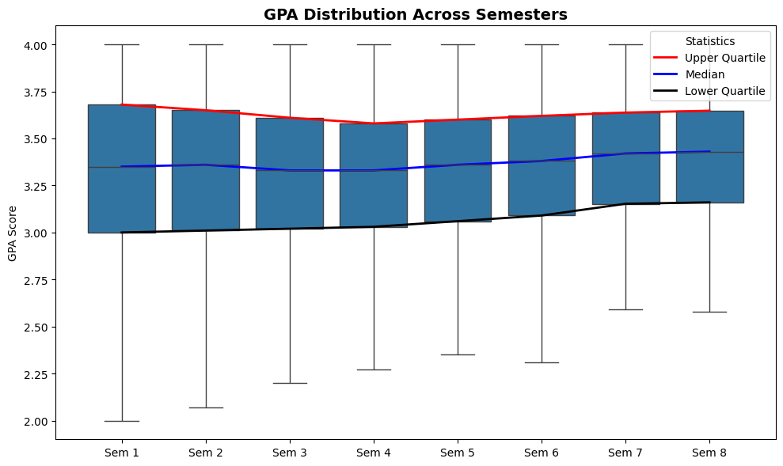
What is the range of BU GPA for student athletes? Does the average student athlete improve their GPA throughout their college year?
Lower Quartile GPA
Lowest GPA
Semester 1: 3.00
Semester 2: 3.01
Semester 3: 3.02
Semester 4: 3.03
Semester 5: 3.06
Semester 6: 3.09
Semester 7: 3.15
Semester 8: 3.16
Semester 1: 1.10
Semester 2: 1.57
Semester 3: 1.86
Semester 4: 2.16
Semester 5: 2.35
Semester 6: 2.31
Semester 7: 2.30
Semester 8: 2.29
Notes:
Minimum BU GPA for student athletes: 1.33
Maximum BU GPA for student athletes: 4.0
GPA Range: [1.33, 4.0]

Slide 8
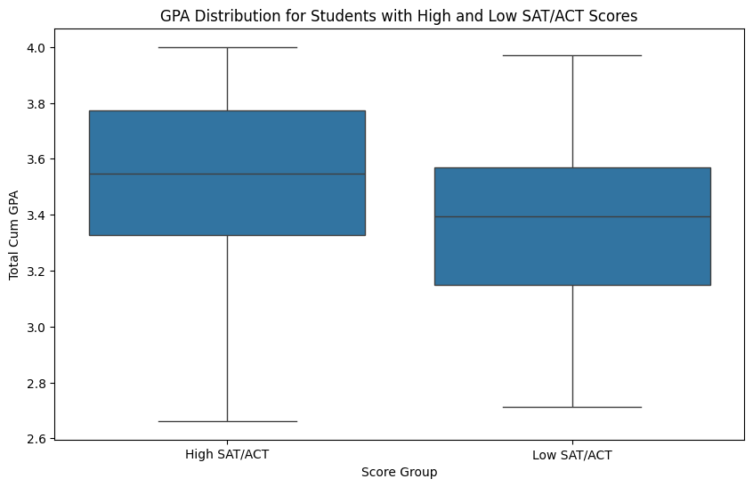
How do these students with high SAT/ACT scores or high GPA perform academically at BU compared to student athletes with low SAT/ACT scores or low GPA?
High SAT/ACT Scores Group:
Median: 3.55
1st Quartile (Q1): 3.33
3rd Quartile (Q3): 3.77
Mean: 3.47
Standard Deviation: 0.43
Low SAT/ACT Scores Group:
Median: 3.39
1st Quartile (Q1): 3.15
3rd Quartile (Q3): 3.57
Mean: 3.35
Standard Deviation: 0.34
Notes:
The range of accepted ACT scores: 22-35 (out of 36)
Out of 623 students, we have 105 submitted ACT scores. With the range from 22-35 out of 36, which is all above the national average 19.9.
The range of accepted SAT scores: 980-1570 (out of 1600)
We have 176 students submitted SAT scores. With the range from 980-1570 out of 1600, 3 falls below national average. 6 students showed outstanding performance, scoring above 1520, which is the national 95th percentile of SAT test

Slide 9
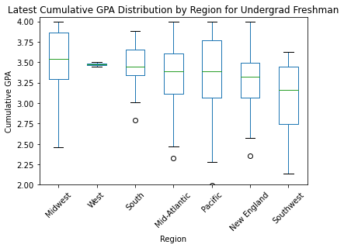
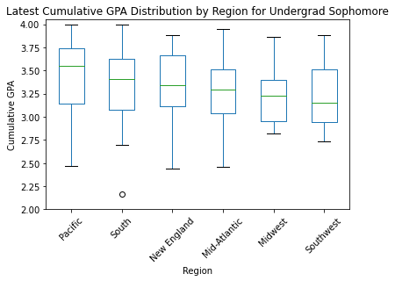
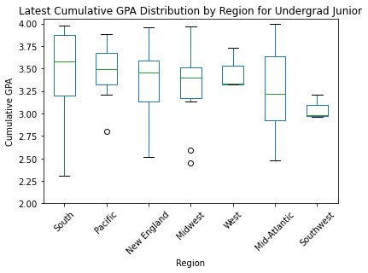
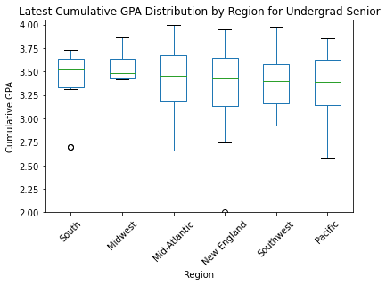
Do students from certain geographic areas perform better academically than other geographic areas?
Domestic
Students from South regions generally perform better academically
The Pacific area also shows strong performance in Sophomore and Junior year
The Southwest region tends to have the lowest median GPA
Notes:
Approach:
For domestic students, group the students by their home admission regions
For international students, group the students by their region of citizenship (detailed country name encrypted)
Compare the latest cumulative GPA
Students from the Midwest and South regions generally perform better academically, with consistently high median GPAs across years. The Pacific also shows strong performance. In contrast, the Southwest region tends to have the lowest median GPAs, suggesting a potential need for academic support.

Slide 10
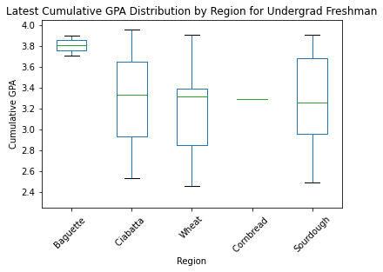
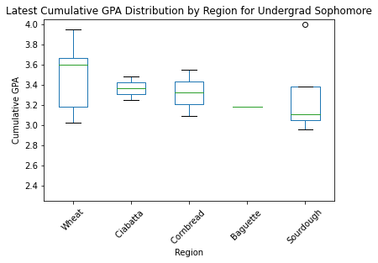
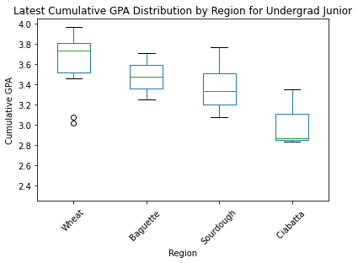
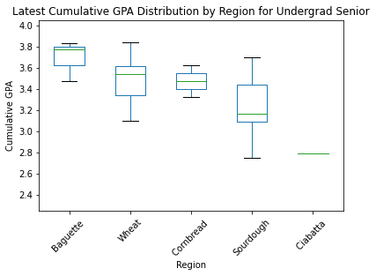
International
Students from Baguette and Wheat regions generally perform better academically
The Ciabatta region shows strong performance in Freshman and Sophomore year, but turns into region with lowest median GPAs in Junior and Senior year
Notes:
International students from the Baguette and Wheat regions appear to perform better academically, with high median GPAs and consistent performance across years.
In contrast, students from Ciabatta show strong performance in first two years, but drop to region with the lowest median GPAs in the last two year, suggesting that they may need additional academic support for Junior and Senior year.
Cornbread and Sourdough regions show moderate performance, students from these regions are achieving respectably but not as high as those from Baguette and Wheat.
Blocker:
Lack of data, the result, especially for international students may be inaccurate (Pita: 2 students, West: 5)
Uneven of the data, 523 domestic VS. 97 international students

Slide 11
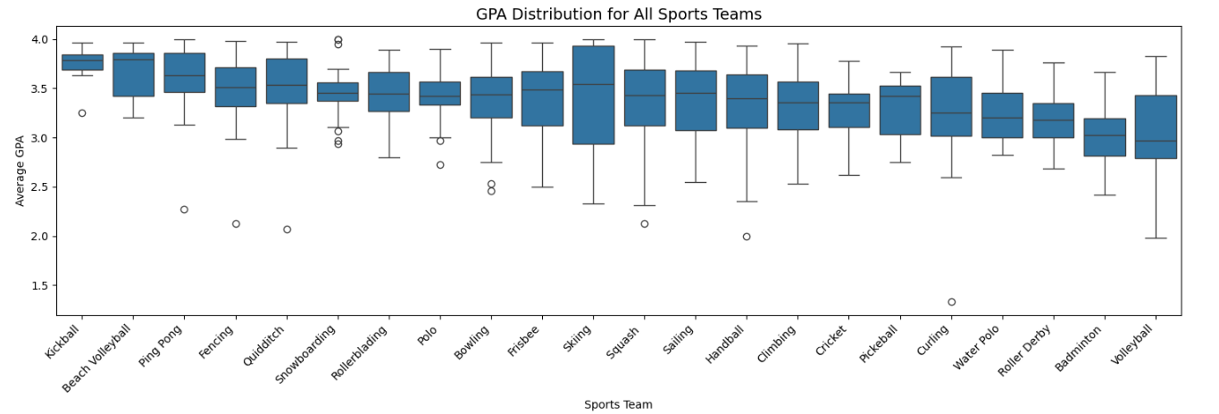
Are there any significant differences in the academic performance of student-athletes based on their sport?
p-value: 0.0000000000005
one-way ANOVA
significant difference exist in academic performance among different sport teams (p<0.05)

Slide 12
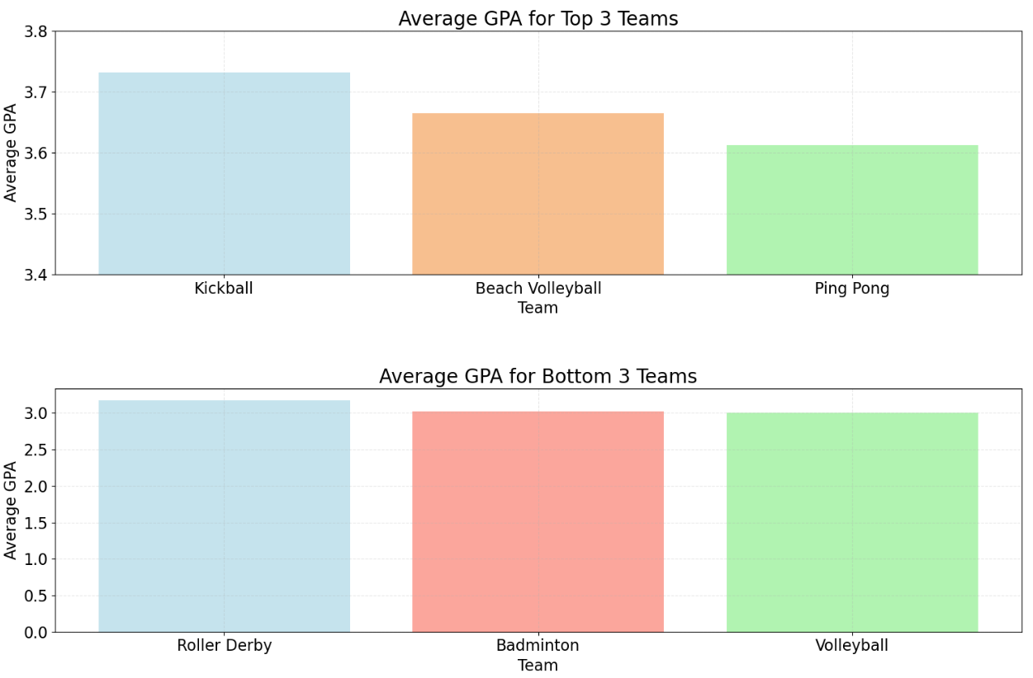
Are there any significant differences in the academic performance of student-athletes based on their sport?
Top 3 Performing Sport Teams
Sport | Mean GPA | 75% above | Count
Kickball | 3.732 | 3.691 | 8
Beach Volleyball | 3.665 | 3.421 | 10
Ping Pong | 3.612 | 3.467 | 30
Bottom 3 Performing Sport Teams
Sport | Mean GPA | 75% below | Count
Roller Derby | 3.177 | 3.350 | 29
Badminton | 3.025 | 3.198 | 58
Volleyball | 3.009 | 3.430 | 17

Slide 13
Additional Analysis
Find if there are trends or correlation with two or more variables
Do students from certain geographic areas with higher HS GPA perform better throughout their college?
Do students from certain geographic region with certain gender, race/ethnicity perform better throughout their college?
Do combinations of sports teams and regions have a significant impact on the academic performance of student-athletes?
Do combinations of primary degree program and regions have a significant impact on the academic performance of student-athletes?
Notes:
using ANCOVA to find two-way and three-way interactions among these variables

Slide 14
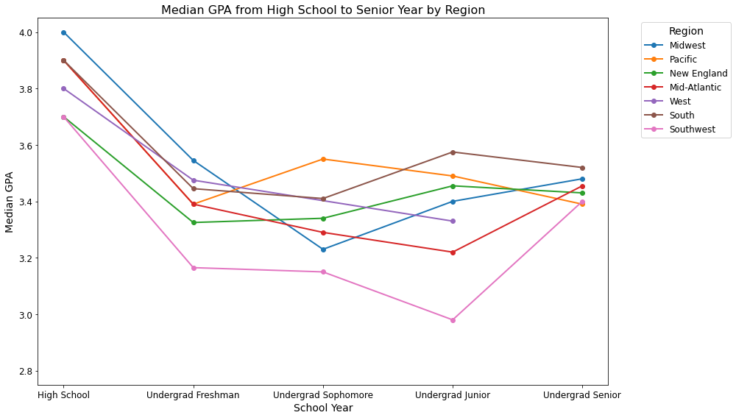
Two-Way Interactions: HS GPA × Geographic Region
Domestic Students
 | HS | Freshman | Sophomore | Junior | Senior
Midwest | 4.0 | 3.545 | 3.23 | 3.400 | 3.480
Pacific | 3.9 | 3.390 | 3.55 | 3.490 | 3.390
Mid-Atlantic | 3.9 | 3.390 | 3.29 | 3.220 | 3.455
South | 3.9 | 3.445 | 3.41 | 3.575 | 3.520
West | 3.8 | 3.475 | / | 3.330 | /
New England | 3.7 | 3.325 | 3.34 | 3.455 | 3.430
Southwest | 3.7 | 3.165 | 3.15 | 2.980 | 3.400
Variable | Coefficient | Std. Err. | t | p-value
HS GPA * South | 0.7073 | 0.249 | 2.845 | 0.005
HS GPA * Southwest | -0.7435 | 0.427 | -1.741 | 0.082
Notes:
The graphs suggest that generally, students entering college with higher high school GPAs are more likely to perform well in college, as reflected in their higher college GPAs.
For domestic students, statistically, there is strong evidence that students from the South region experience a unique interaction where their high school GPA contributes more strongly to their college GPA compared to the baseline region.
The Southwest region shows some near-significant trends, where students may perform better overall but with diminishing returns for high school GPA.

Slide 15
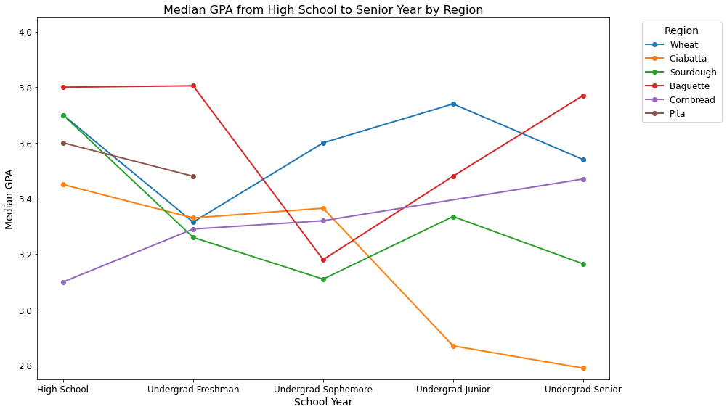
Find if there are trends or correlation with two or more variables (e.g. Do students from certain geographic areas with higher HS GPA perform better throughout their college)
International Students
 | HS | Freshman | Sophomore | Junior | Senior
Baguette | 3.8 | 3.805 | 3.180 | 3.480 | 3.770
Wheat | 3.7 | 3.315 | 3.600 | 3.740 | 3.540
Sourdough | 3.7 | 3.260 | 3.110 | 3.335 | 3.165
Pita | 3.6 | 3.480 | / | / | /
Ciabatta | 3.45 | 3.330 | 3.365 | 2.870 | 2.790
Cornbread | 3.1 | 3.290 | 3.320 | / | 3.470
Notes:
lack of data, less accurate
Baguette and Wheat: generally perform better (have higher HS GPA)
Ciabatta: perform worse and worse (has the second lowest HS GPA)
Still can’t conclude that HS GPA is a definite factor in impacting GPA because of the sample size:
Baguette: 8 while Wheat: 43 (the sudden drop in Sophomore year in Baguette could due to lack of sample), the Wheat data reflects more near to true circumstances)
Ciabatta: 9

Slide 16
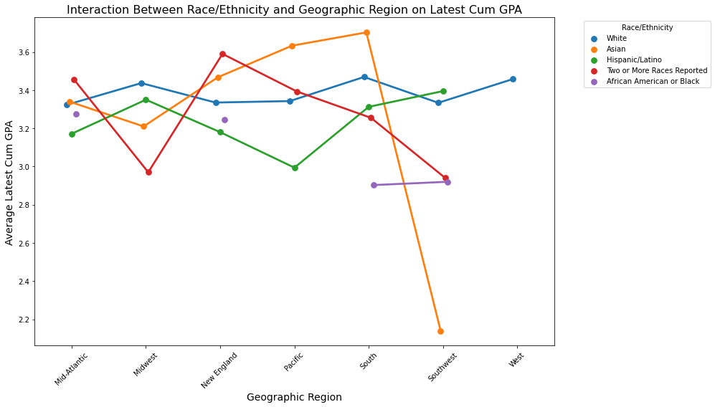
Two-Way Interactions: Race/Ethnicity × Geographic Region
Variable | Coefficient | Std. Err. | t | p-value
Asian × Southwest | -1.2100 | 0.438 | -2.760 | 0.006
African American or Black × South | -0.5162 | 0.204 | -2.531 | 0.012
Two or More Races × Midwest | -0.5987 | 0.308 | -1.943 | 0.053
Red: Statistically Significant (p < 0.05)
Blue: Statistically Near-to-Significant (p-value close to 0.05)
Notes:
Sample size: only done with domestic students
Significant two-way interactions indicate that Asian students in the Southwest, African American or Black students from South perform worse than their counterparts.
Asian × Southwest: Asian students from the Southwest also exhibit significantly lower GPAs compared to the reference group (p=0.006, coefficient = -1.2100).
African American × South: African American or Black students from the South show significantly lower GPAs (p=0.012, coefficient = -0.5162).
Two or More Races × Midwest: Students with two or more races reported from Midwest may perform slightly worse (p = 0.053, coefficient = -0.5987)

Slide 17
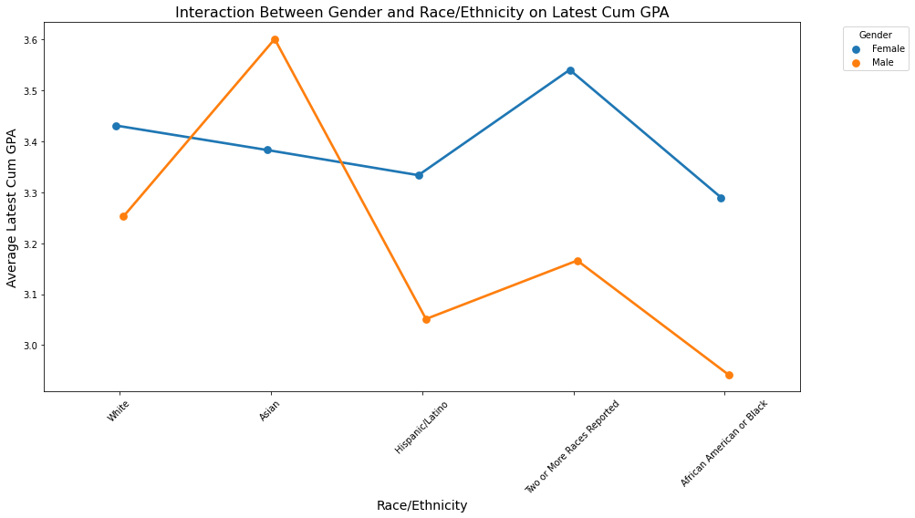
Two-Way Interactions: Race/Ethnicity × Gender
Variable | Coefficient | Std. Err. | t | p-value
Asian × Male | 0.3965 | 0.155 | 2.544 | 0.011
Notes:
Another significant two-way interactions indicate that Asian male students have significantly higher college GPAs.
Significant Interaction:Male × Asian: The coefficient is positive (0.3965) and statistically significant (p = 0.011). This suggests that Asian male students perform significantly better in terms of cumulative GPA compared to their female counterparts within the Asian group.
From graph: Female students display more consistent performance across race/ethnicity groups, with relatively smaller variations in average cumulative GPA. This indicates that gender has less influence on GPA within female groups across race/ethnicity compared to males.

Slide 18
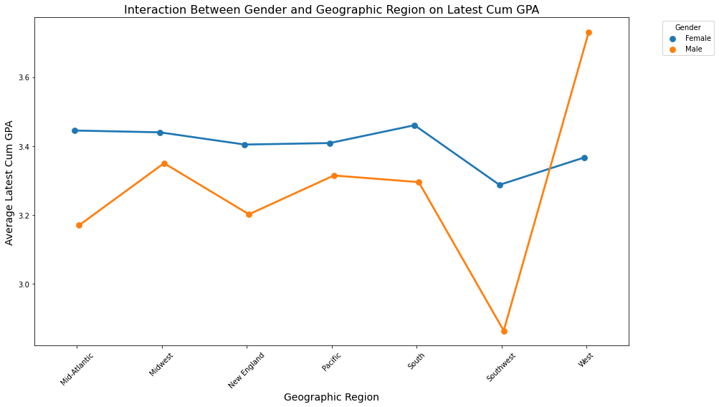
Two-Way Intersections: Gender × Geographic Region
No statistically significant interaction found (all interactions have p-value > 0.05)
Female students tend to have more consistent average GPAs across regions. Also, generally outperform male students in terms of average cumulative GPA
Notes:
There is a significant dip in male GPAs for a specific(Southwest) region, followed by a dramatic increase in another (West) region. This suggests that male students' performance is more regionally sensitive. This might also due to the insufficient sample sizes for some regions (only 6 male samples from Southwest region)

Slide 19
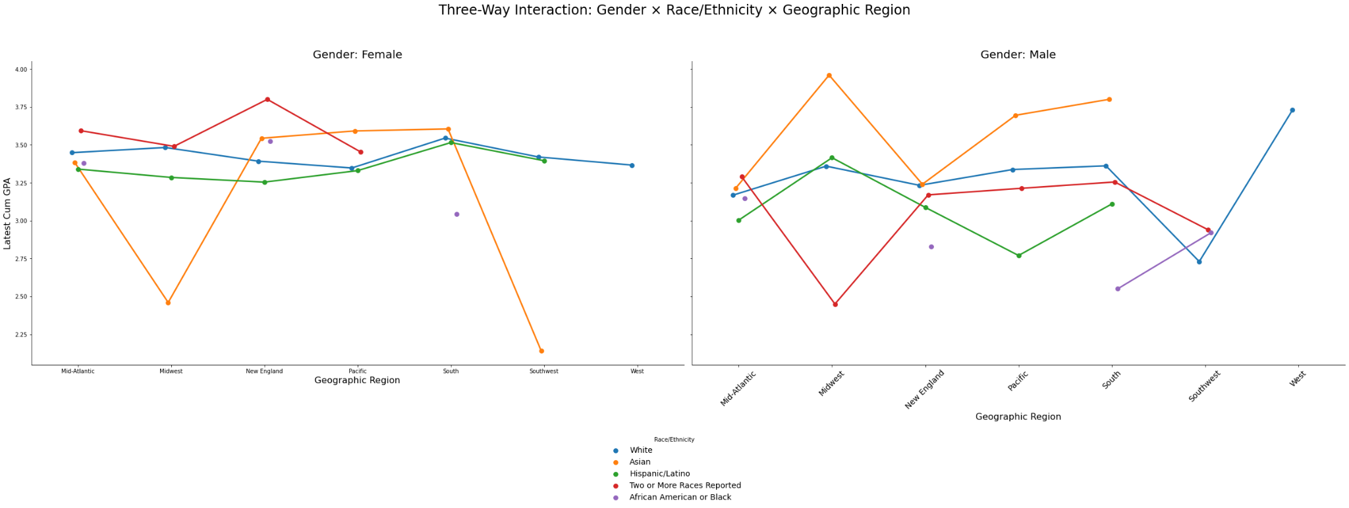
Three-Way Interactions: Gender × Race/Ethnicity × Geographic Region
Variable | Coefficient | Std. Err. | t | p-value
Asian × Male × Midwest | 1.5093 | 0.630 | 2.395 | 0.017
Asian × Female × Midwest | 2.4600 | 0.454 | 5.42 | < 0.001
Asian × Female × Southwest | 2.1400 | 0.487 | 4.39 | <0.001
Notes:
Conversely, a significant three-way interaction shows that male Asian students from the Midwest outperform expectations.
Asian Male Midwest: Asian male students from the Midwest exhibit significantly higher GPAs compared to the reference group (p=0.017, coefficient = 1.5093).
Asian Female Midwest/Southwest: The high positive coefficient means the interaction group (e.g., Asian females in Midwest or Southwest) has a higher predicted GPA relative to the baseline, but the group's absolute GPA is much lower than others.

Slide 20
Additional Questions
Do combinations of sports teams and regions have a significant impact on the academic performance of student-athletes?
Approach:
Build a linear regression model and perform Two-way ANOVA to test the effects of sports teams, regions, and their interaction on GPA.
Key Insight:
The interaction between specific sports teams and regions shows statistically weaker effects on GPA for some combinations.
Squash × New England
Fencing × Southwest
Rollerblading × Southwest
Certain combinations of sports teams and regions consistently display lower GPAs.
Badminton × Mid-Atlantic
Badminton × New England
Climbing × New England

Slide 21
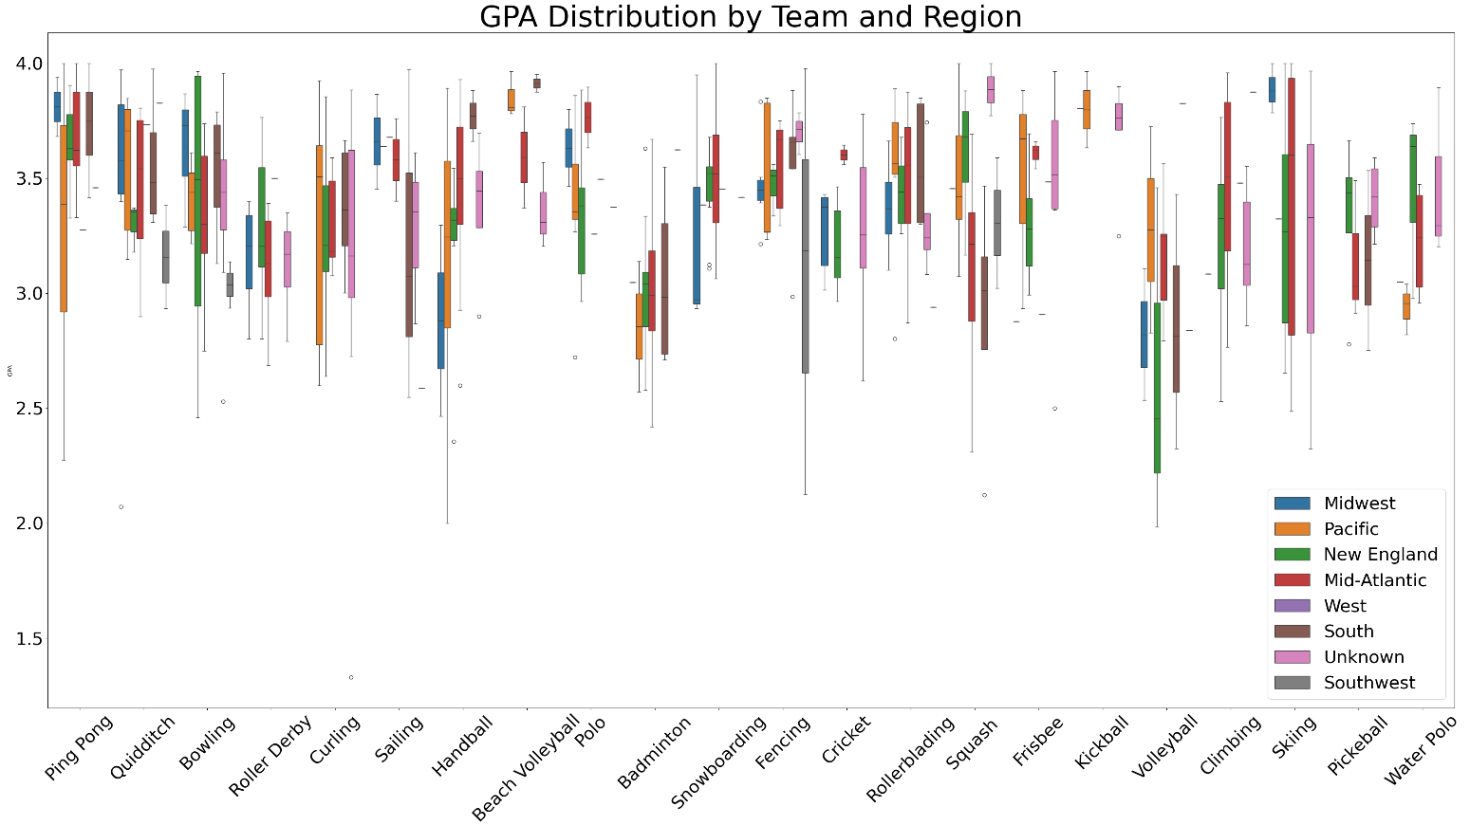
Do combinations of sports teams and regions have a significant impact on the academic performance of student-athletes?
 | coefficient | sta err | t-statistic | p-value
Squash × New England | 0.51 | 0.22 | 2.36 | 0.019
Fencing × Southwest | -1.076 | 0.47 | -2.28 | 0.023
Rollerblading × Southwest | -1.14 | 0.57 | -1.99 | 0.046

Slide 22
Do combinations of sports teams and regions have a significant impact on the academic performance of student-athletes?
Different sports teams (Badminton and Climbing) from the same region (New England) simultaneously show low GPAs.
Badminton student athletes from two different regions( Mid-Atlantic, New England) have low GPAs.
Lowest GPA Combinations
1 | Team | Region | GPA | Count
2 | Volleyball | Midwest | 2.82 | 2
3 | Volleyball | New England | 2.63 | 3
4 | Sailing | Southwest | 2.59 | 1
Lowest GPA Combinations (Count>10)
1 | Team | Region | GPA | Count
2 | Badminton | Mid-Atlantic | 3.01 | 32
3 | Badminton | New England | 3.02 | 18
4 | Climbing | New England | 3.24 | 12

Slide 23
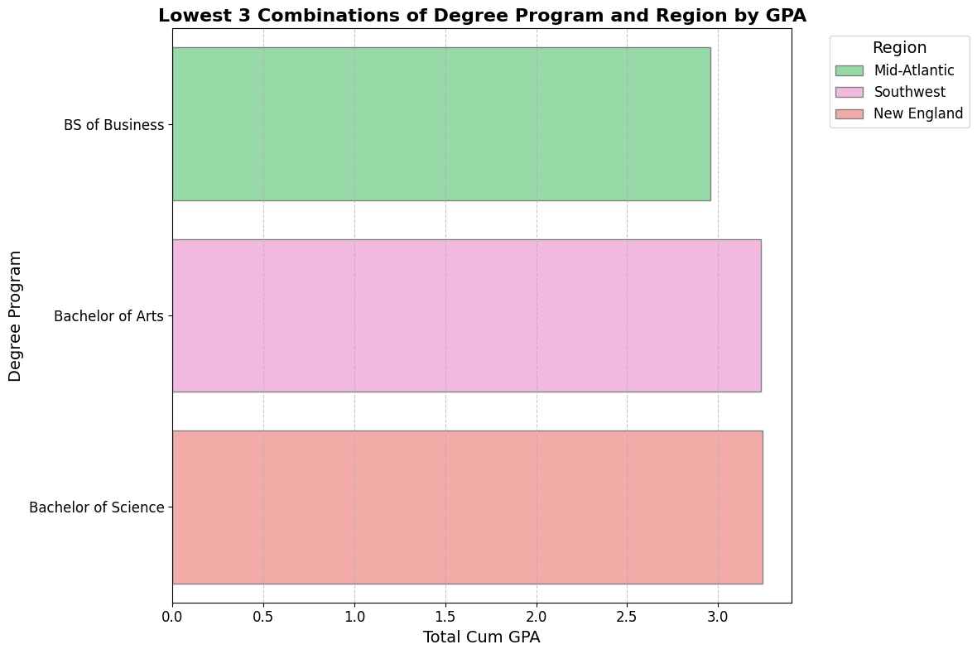
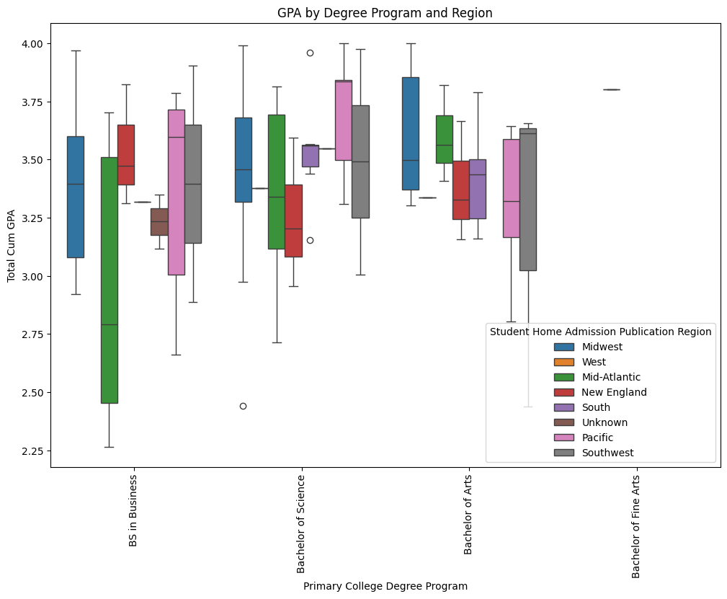
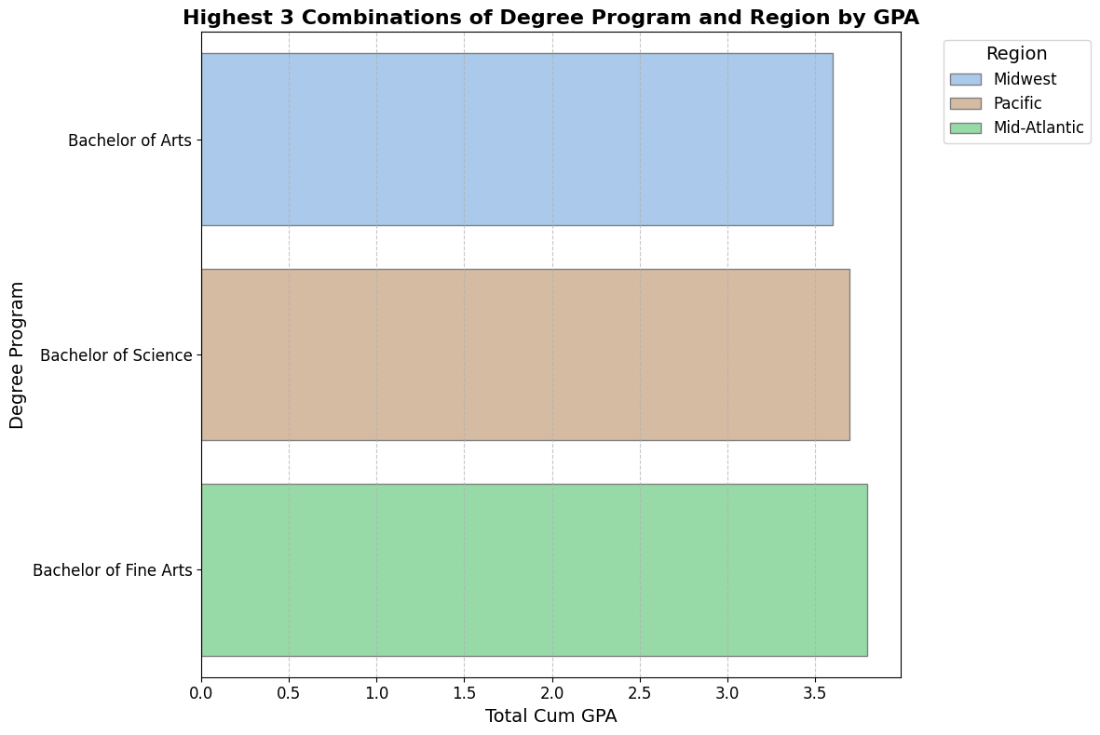
Do combinations of degree program and regions have a significant impact on the academic performance of student-athletes?
2.96
3.23
3.24
3.59
3.69
3.80
sum_sq: 0.68
df: 7
F: 0.646
PR(>F): 0.527
Notes:
Do combinations of primary degree program and regions have a significant impact on the academic performance of student-athletes?
Conclusion: In general, combination of primary degree program and regions has no significant impact on academic performance.

Slide 24
Base Analysis Conclusion
Language Proficiency: Not a significant barrier for long-term academic success. International students may require additional academic support during their freshman year.
Standardized Test Scores: All BU student-athletes scored moderate to high on SAT/ACT. Higher SAT/ACT scores correlate with better college performance, supporting their use in recruitment decisions.
Geographic Trends:
Domestic Students:
Students from South and Pacific regions perform better academically.
Students from Southwest region may need additional academic support.
International Students:
Students from Baguette and Wheat regions perform better.
Students from Ciabatta region struggle, particularly in their Junior and Senior years.
Sport Team:
Top 3 Academic Performing Sport Teams: Kickball、Beach Volleyball、Ping Pong
Bottom 3 Academic Performing Sport Teams: Roller Derby、Badminton、Volleyball

Slide 25
Additional Analysis Conclusion
Two-Way & Three-Way Interactions:
Outstanding Academic Performance:
Asian males, especially from the Midwest region, consistently outperform.
Student-athletes from Mid-Atlantic participating in the Snowboarding team are likely to perform better academically.
Downstanding Academic Performance:
Asian students from Southwest and Black students from South underperform compared to others.
Student-athletes from Mid-Atlantic participating in the Badminton team may have relatively weaker academic performance.
Student-athletes from New England participating in the Badminton team may have relatively weaker academic performance.
Complex Outcomes:
Asian females from Midwest and Southwest show high predicted GPAs relative to baseline, but their absolute GPAs are lower than other groups.

Slide 26
Future Insights
Limited Sample Size: The study was based on a small dataset (624 records), potentially affecting accuracy and depth of findings.
Restricted Variables: Key variables influencing academic performance, such as study hours, training intensity, and resource access, were not included.
Future Focus:
Collect a larger, more representative dataset.
Incorporate additional variables to better understand academic outcomes.
Goal: Provide more reliable findings to help BU Athletics enhance student support systems and improve recruitment strategies for prospective student-athletes.

Slide 27
Question Time

Slide 28

Thank you!

